Slide 1
Programming ‘Final Work’ {
beginning.h
intro.h
[Sort methods on C++]
< 1st Telecommunications Eng.>
< Team 01: Bubble & Merge Sort>
}
//Sta Clara, Villa Clara 2023

Slide 2
translate(‘Intro’) {
big_o.h
intro.h
< >
}
Programming Language

Slide 3
01 {
[Big O Notation]
big_o.h
importance.h
< Big O notation in C++ is a way to express the time complexity of an algorithm or the upper bound on the growth rate of the algorithm's running time. It provides a high-level understanding of how the performance of an algorithm scales with the size of the input.>
}
Programming Language

Slide 4
Importance of ‘Big O’ {
bubble_sort.h
importance.h
Algorithm Comparison
It helps in choosing the most suitable algorithm for a specific problem
Performance Prediction
Provides a theoretical upper bound on the running time of an algorithm as the input size grows
Optimization Strategies
Developers can focus on improving the most significant contributors to the algorithm's time complexity.
Educational Tool
Is an essential concept taught in computer science and programming courses
}
Programming Language

Slide 5
10 {
[Bubble Sort]
bubble_sort.h
example.h
< Bubble Sort is a simple sorting algorithm that repeatedly steps through the list, compares adjacent elements, and swaps them if they are in the wrong order. The pass through the list is repeated until the list is sorted. The algorithm gets its name because smaller elements "bubble" to the top of the list with each pass.>
3
1
5
2
4
}
Programming Language

Slide 6
coding.h
example.h
3
1
5
2
4
Programming Language

Slide 7
coding.h
example.h
1
3
5
2
4
Programming Language

Slide 8
coding.h
example.h
1
3
5
2
4
Programming Language

Slide 9
coding.h
example.h
1
3
2
5
4
Programming Language

Slide 10
coding.h
example.h
1
3
2
4
5
Programming Language

Slide 11
coding.h
example.h
1
3
2
4
5
Programming Language

Slide 12
coding.h
example.h
1
3
2
4
5
Programming Language

Slide 13
coding.h
example.h
1
2
3
4
5
Programming Language

Slide 14
coding.h
example.h
1
2
3
4
5
Programming Language

Slide 15
coding.h
example.h
1
2
3
4
5
Programming Language

Slide 16
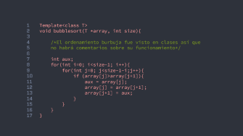

Coding{
3
coding.h
2
5
}
Programming Language
1
4

Slide 17
1
2
3
4
5
6
7
8
9
10
11
12
13
14
15
16
17
Template<class T>
void bubblesort(T *array, int size){
/*El ordenamiento burbuja fue visto en clases así que
no habrá comentarios sobre su funcionamiento*/
int aux;
for(int i=0; i<size-1; i++){
for(int j=0; j<size-1-i;j++){
if (array[j]>array[j+1]){
aux = array[j];
array[j] = array[j+1];
array[j+1] = aux;
}
}
}
}

Slide 18
11 {
[Merge Sort]
merge_sort
examplem.h
< Merge Sort is a popular and efficient sorting algorithm that follows the divide-and-conquer paradigm. It works by recursively dividing the input array into smaller halves, sorting each half separately, and then merging them back together in a sorted manner.>
}
Programming Language

Slide 19
codingm.h
examplem.h
3
1
5
2
4
Programming Language

Slide 20
codingm.h
examplem.h
3
1
5
2
4
7
6
Programming Language

Slide 21
codingm.h
examplem.h
3
1
5
2
4
7
6
3
1
5
2
4
7
6
5
2
5
2
Programming Language

Slide 22
codingm.h
examplem.h
3
1
5
2
4
7
6
3
1
5
2
4
4
7
7
6
6
3
1
5
2
Programming Language

Slide 23
codingm.h
examplem.h
3
1
5
2
4
7
6
3
1
5
2
4
7
6
1
3
2
5
4
7
7
6
6
3
1
5
2
4
4
7
6
3
3
1
1
5
5
2
2
4
Programming Language

Slide 24
codingm.h
examplem.h
3
1
5
2
4
7
6
3
1
5
2
4
7
6
3
1
5
2
4
7
6
1
3
2
5
4
7
7
6
6
3
1
5
2
4
Programming Language

Slide 25
codingm.h
examplem.h
3
1
5
2
4
7
6
3
1
5
2
4
7
6
3
1
5
2
4
7
6
3
1
5
2
4
7
6
1
1
3
2
2
3
5
5
4
4
6
7
7
6
Programming Language

Slide 26
codingm.h
examplem.h
3
1
5
2
4
7
6
3
1
5
2
4
7
6
3
1
5
2
4
7
6
3
1
5
2
4
7
6
1
3
2
5
4
7
6
1
2
5
4
5
6
7
1
2
3
3
4
6
7
Programming Language

Slide 27
codingm.h
examplem.h
3
1
5
2
4
7
6
3
1
5
2
4
7
6
3
1
5
2
4
7
6
3
1
5
2
4
7
6
1
3
2
5
4
7
6
1
2
3
5
4
6
7
1
2
3
4
5
6
7
Programming Language

Slide 28
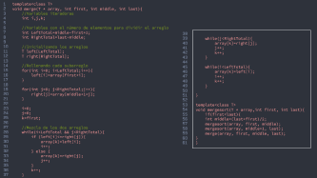

Coding{
codingm.h
}
Programming Language

Slide 29
1
2
3
4
5
6
7
8
9
10
11
12
13
14
15
16
17
18
19
20
21
22
23
24
25
26
27
28
29
30
31
32
33
34
35
36
37
template<class T>
void merge(T * array, int first, int middle, int last){
//Variables iteradoras
int i,j,k;
//Variables con el número de elementos para dividir el arreglo
int LeftTotal=middle-first+1;
int RightTotal=last-middle;
//Inicializando los arreglos
T left[LeftTotal];
T right[RightTotal];
//Rellenando cada subarreglo
for(int i=0; i<LeftTotal;i++){
left[i]=array[first+i];
}
for(int j=0; j<RightTotal;j++){
right[j]=array[middle+1+j];
}
i=0;
j=0;
k=first;
//Mezcla de los dos arreglos
while(i<LeftTotal && j<RightTotal){
if (left[i]<=right[j]){
array[k]=left[i];
i++;
} else {
array[k]=right[j];
j++;
}
k++;
}
38
39
40
41
42
43
44
45
46
47
48
49
50
51
52
53
54
55
56
57
58
59
60
61
while(j<RightTotal){
array[k]=right[j];
j++;
k++;
}
while(i<LeftTotal){
array[k]=left[i];
i++;
k++;
}
}
template<class T>
void mergesort(T * array,int first, int last){
if(first<last){
int middle=(last+first)/2;
mergesort(array, first, middle);
mergesort(array, middle+1, last);
merge(array, first, middle, last);
}
}

Slide 30

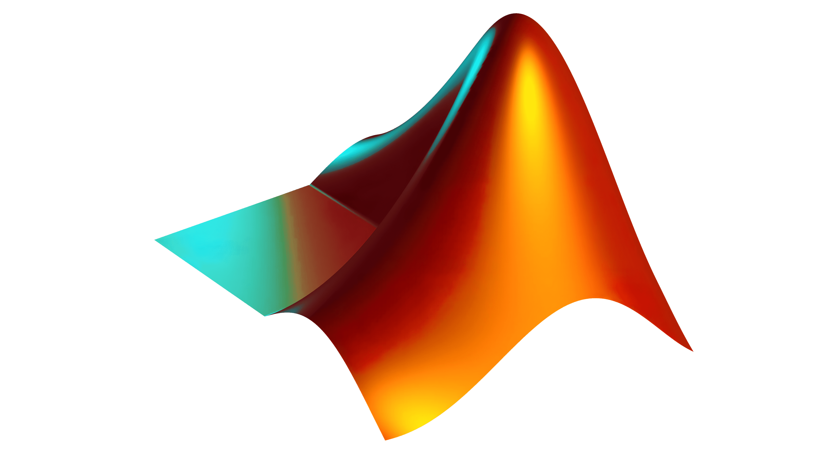

GitHub
.git/src
MatLab
Include
Convert_to_
string.m
graphics.m
generating.m

Slide 31


GitHub
.git/src
MatLab
Include
Convert_to_
string.m
graphics.m
generating.m

Slide 33
1
2
3
4
5
6
7
8
9
10
11
12
13
14
15
16
17
function converted = convert_to_string(x)
numstr=num2str(x);
strconcomas=strjoin(cellstr(numstr));
converting=strrep(strconcomas,' ',',');
converting2=strrep(converting,',,,,,',',');
converting3=strrep(converting2,',,,,',',');
converting4=strrep(converting3,',,,',',');
converting5=strrep(converting4,',,',',');
converted=converting5;
end

Slide 35
1
2
3
4
5
6
7
8
9
10
11
12
13
14
15
16
17
18
19
20
21
22
23
24
25
26
27
28
29
30
31
32
33
34
35
36
37
%Disribución uniforme
%Juego de datos 0001
datos1=randi(100,1,40);
strdatos1=convert_to_string(datos1);
%Juego de datos 0010
datos2=randi(10000,1,800);
strdatos2=convert_to_string(datos2);
%Juego de datos 0011
datos3=randi(10000,1,4000);
strdatos3=convert_to_string(datos3);
%Distribución normal
%Juego de datos 0011
datos4=randn(1,40);
strdatos4=convert_to_string(datos4);
%Juego de datos 0101
datos5=randn(1,800);
strdatos5=convert_to_string(datos5);
%Juego de datos 0110
datos6=randn(1,4000);
strdatos6=convert_to_string(datos6);
%Distribución chicuadrado
%Juego de datos 0111
degrees=5;
datos7=chi2rnd(degrees,1,40);
strdatos7=convert_to_string(datos7);
%Distribución chicuadrado
%Juego de datos 1000
degrees=5;
38
39
40
41
42
43
44
45
46
47
48
49
50
51
52
53
54
55
56
57
58
59
60
61
62
63
datos8=chi2rnd(degrees,1,800);
strdatos8=convert_to_string(datos8);
%Distribución chicuadrado
%Juego de datos 1001
degrees=5;
datos9=chi2rnd(degrees,1,4000);
strdatos9=convert_to_string(datos9);
%Distribución chicuadrado
%Juego de datos 1010
tasa=5;
datos10=poissrnd(degrees,1,40);
strdatos10=convert_to_string(datos10);
%Distribución chicuadrado
%Juego de datos 1011
tasa=5;
datos11=poissrnd(degrees,1,800);
strdatos11=convert_to_string(datos11);
%Distribución chicuadrado
%Juego de datos 1100
tasa=5;
datos12=poissrnd(degrees,1,4000);
strdatos12=convert_to_string(datos12);

Slide 36

GitHub
.git/src
MatLab
Include
Convert_to_
string.m
graphics.m
juegoDeDatos.h
Timerfunction.h
generating.m
Sort.h

Slide 38
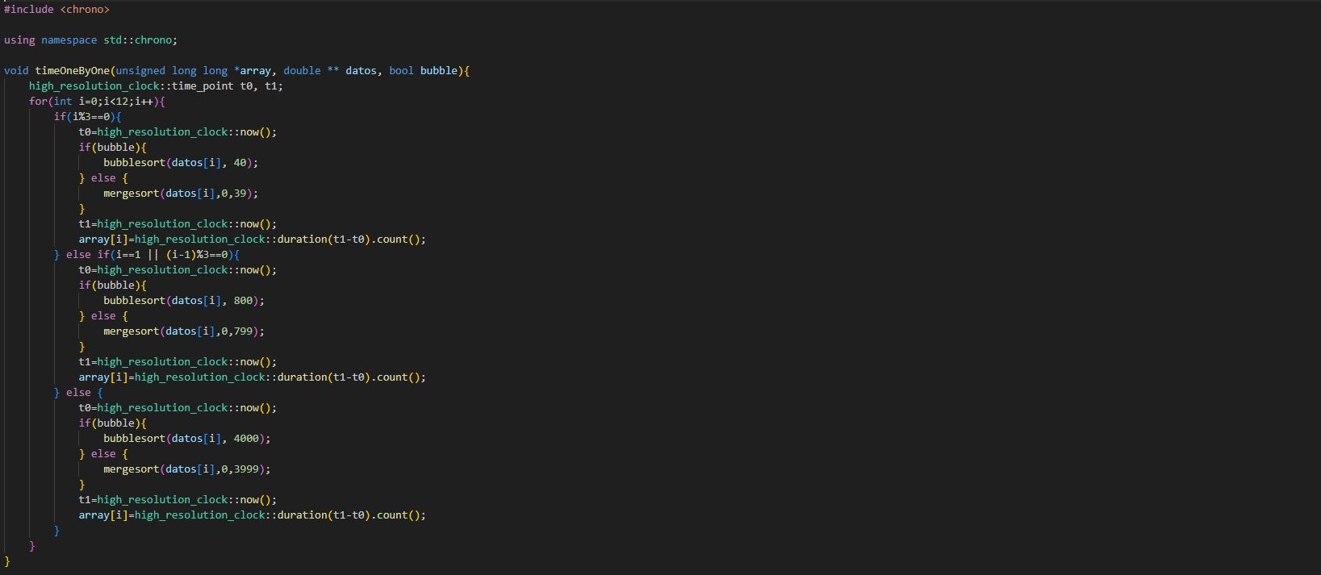
1
2
3
4
5
6
7
8
9
10
11
12
13
14
15
16
17
18
19
20
21
22
23
24
25
26
27
28
29
30
31
32
33
34
35
36
37
#include <chrono> using namespace std::chrono;
void timeOneByOne(unsigned long long *array, double ** datos, bool bubble){
high_resolution_clock::time_point t0, t1;
for(int i=0;i<12;i++){
if(i%3==0){
t0=high_resolution_clock::now();
if(bubble){
bubblesort(datos[i], 40);
} else {
mergesort(datos[i],0,39);
}
t1=high_resolution_clock::now();
array[i]=high_resolution_clock::duration(t1-t0).count();
} else if(i==1 || (i-1)%3==0){
t0=high_resolution_clock::now();
if(bubble){
bubblesort(datos[i], 800);
} else {
mergesort(datos[i],0,799);
}
t1=high_resolution_clock::now();
array[i]=high_resolution_clock::duration(t1-t0).count();
} else {
t0=high_resolution_clock::now();
if(bubble){
bubblesort(datos[i], 4000);
} else {
mergesort(datos[i],0,3999);
}
t1=high_resolution_clock::now();
array[i]=high_resolution_clock::duration(t1-t0).count();
}
}
}

Slide 39

GitHub
.git/src
MatLab
Include
Convert_to_
string.m
graphics.m
juegoDeDatos.h
Timerfunction.h
generating.m
Sort.h

Slide 41
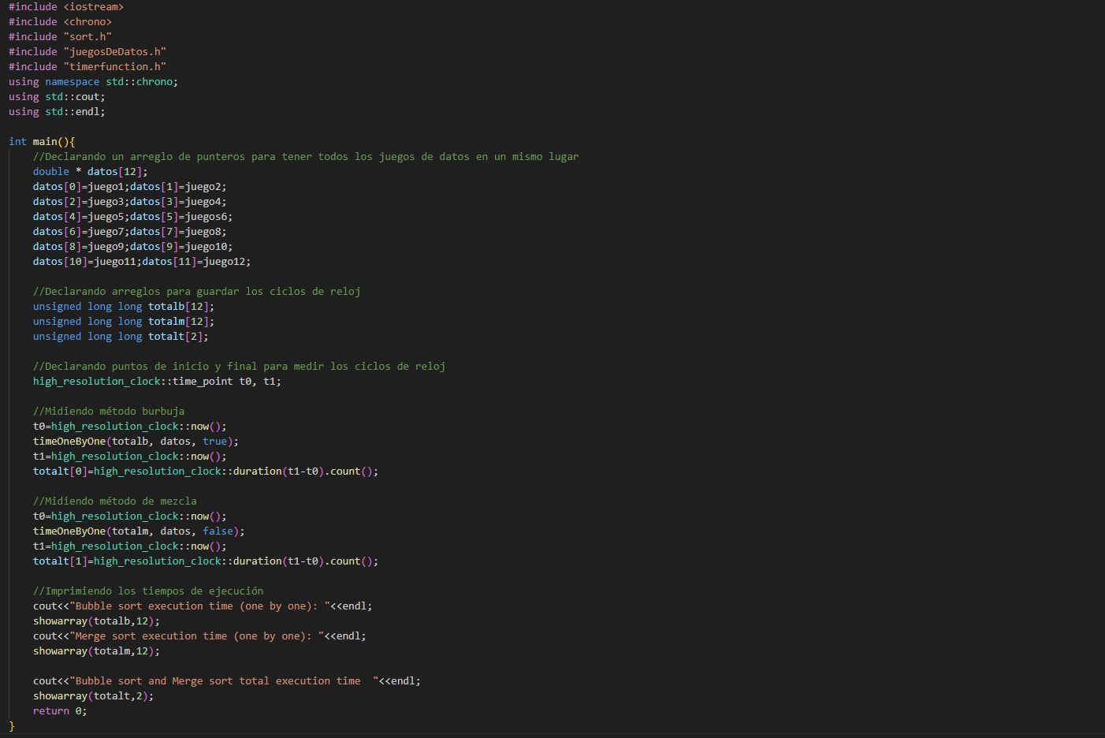

Slide 42
Bubble
comparisson.h
bubble_results.h
{
vs
Merge;
}
Programming Language

Slide 43
Bubble
bubble_res.h
bubble_results.h
{
}
Programming Language
Merge;

Slide 44
Bubble
bubble_results.h
bubble_results_graph.h
{
}
Uniforme Normal Poisson Cuadrado
Programming Language
Merge;

Slide 45
Bubble
bubble_results_graph.h
bubble_results.h
{
}
Programming Language
Merge;

Slide 46
Bubble
comparisson.h
bubble_results.h
{
vs
Merge;
}
Programming Language

Slide 47
Bubble
Merge
comparisson.h
bubble_results.h
{
}
Programming Language

Slide 48
Merge
merge_results.h
merge_results_graph.h
{
}
Uniforme Normal Poisson Cuadrado
Programming Language
Bubble

Slide 49
Merge
merge_results_graph.h
bubble_results.h
{
}
Programming Language
Bubble

Slide 50
Both
comparisson.h
comparisson_size.h
{
}
Programming Language
Bubble

Slide 51
800
40
4000
comparisson_size.h
{
}
Programming Language
Bubble

Slide 52
translate(‘End’) {
big_o.h
end.h
< >
}
Programming Language

